Slide 1

Valtis
Current State & What Phase 1 Delivers
Valtis works today as a pilot — it has a knowledge layer but has no sign-in, no enterprise deployment, and no service surface
AZ needs a usable frontdoor: sign in → pick a program → generate a deck/brief (or convene an advisory board) → download — simple enough to need no manual
Outputs must stay fail-closed: every material claim carries its source, drawing on the knowledge layer plus real-time competitor evidence; unsourced outputs are withheld
Phase 1 (12 weeks) delivers the secure deployment, sign-on, the frontdoor, and grounded deck/brief generation with export — plus a demonstrable advisory-board foundation
Oncology Advisory Board — Productionization
Frontdoor · Grounded Output Generation · Governed & AWS-Native
Proposed Solution
What Phase 1 Adds
Business Benefits
We productionize Valtis in place across three gated phases. Phase 1 stands up the enterprise shell (secure AWS deployment + SSO) and the product surface AZ cares about most: a frontdoor where an authenticated program leader generates a grounded, exportable program deck or brief — the AMG-193-style output — from the knowledge layer plus live competitor evidence. Governance, connectors and the full advisory board follow in Phases 2–3.
A Frontdoor & UX
Sign in → select program → request output → download; report-generator buttons; honest waiting & failure screens.
Grounded output generation
multi-slide program deck + competitive brief in fixed formats; fail-closed checks; export to PPTX/DOCX/PDF.
Real-time competitor evidence
CT.gov, PubMed, press/IR and web — dated, source-linked, feeding the generators.
Advisory-board foundation
A simulated persona panel demonstrated over the knowledge layer (seed for Phases 2–3).
A usable product in 2026
Program leaders self-serve grounded decks and briefs in minutes — no manual required.
Trust by construction
Every claim cited; unsourced outputs withheld, never published broken.
Enterprise-ready
SSO, access roles, monitoring and audit; nothing leaves the AZ tenant.
A clear path to scale
Governed multi-user, connectors and the full advisory board follow in gated phases.
Investment
Reverse Timeline
Success Factors & Risk
Minimum Requirements
$343k
Project Kickoff: within 5 business days of SOW approval
Phase 1 Delivery: 12 weeks from kickoff, fixed scope
Discovery & secure deploy wks 1–5; frontdoor + generators wks 4–10; SSO/AuthZ throughout; real-time evidence wks 5–9; SAB foundation wks 8–11; validation & handover wk 12.
Success Factors
Risks
AWS Landing Zone: MASS account + contacts; ECR, Fargate, Secrets Mgr, S3, egress.
Data & Model Access: migrated Postgres KL; approved LLM via AI-Gateway + token budget.
Content Authority: prompts, rubrics & gates stay under AZ change control; frozen pilot corpus at Gate 1.
Decision Owner: an AZ sponsor to confirm the one committed output & fixed scope.
Landing zone & Postgres KL access
IdP/SAML + AI-Gateway ready
Frozen pilot corpus (Gate 1)
Prompts/rubrics under AZ authority
External-source egress allow-listed
MSA / confidentiality sign-off
CISO expectations & cloud access
Source licensing (congress) open
Real-time source rate limits
SAB scope kept to demo in P1
Phase 1 — 12 weeks, fixed fee. Detailed Discovery sessions, securedeployment, authentication and sign-on. Full 3-phase roadmap ~ each phase gated for AZ decision
Rough Order of Magnitude — v0.3 (draft)
SHI | Confidential & Proprietary Information

Slide 2
Productionizing Valtis — From Pilot to Product
A single, staged progression. Phase 1 now delivers the frontdoor and grounded output generation — the product surface — alongside secure deployment.
TODAY
→
PHASE 1
→
PHASE 2
→
PHASE 3
Working Pilot
Secure Product Surface
Governed Multi-User
Extensible Platform
Pre-built Knowledge Layer
Single-user, runs ad-hoc
Grounded answers, POC-grade
No Sign-in/AuthZ/AuthN
No deployment artifact
No validated Frontdoor
Secure AWS deploy + SSO/AuthZ
Frontdoor + deck/brief generation
Real-time evidence · SAB foundation
Entitlement, audit, sessions
SharePoint + BIKG connectors
SAB governed; pilot ≤50 SMEs
Advanced templates + cache
Analytics; pluggable gateway
SAB advanced; scale to 500+
Why Phase 1 leads with the product surface: AZ's priority is a usable service — a program leader signing in and getting one approved, grounded deck. So Phase 1 pairs the enterprise shell (secure deploy + SSO) with the frontdoor and the grounded generators, and seeds the advisory-board experience. Governance and scale then harden a product that already delivers value.
SHI | Confidential & Proprietary Information

Slide 3
Reference Architecture & Data Flow
Two decoupled paths inside AZ's cloud. Entitlement follows the user; grounding is enforced at the gate.
ASTRAZENECA CLOUD ENVIRONMENT · DATA AND MODELS NEVER LEAVE THE TENANT
INGESTION PATH · built once, nothing enters unverified
Sources
→
Tier
→
Gate
→
Build KG
→
Write KL
congress · PubMed · CT.gov · PR/IR
authority + corroboration
deterministic · fail-closed
edges + qualifiers
provenance · RLS-scoped
The gate is the safety mechanism — rule-based, reproducible, no LLM. Restricted or cross-wired claims never enter the knowledge layer.
GOVERNED QUERY PATH · entitlement follows the user, grounding at the citation
AZ User
→
Entitlement filter
→
Retrieve + Rerank
→
Ground + Cite
→
Output
→
Audit + Meter
SSO + persona
only cleared docs
vector + metadata
ACL-redacted
chat / structured/reports/slide-decks
log + tokens
Entitlement is enforced at retrieval, not left to the LLM; citations are redacted to the source ACL — closing the extract-leakage path.
Phasing: Phase 1 delivers the query path behind SSO with basic citation, report generation, SAB foundation. Phase 2 adds entitlement filtering, ACL-redacted grounding, sharepoint connectors, audit & metering. Phase 3 adds configurable structured outputs, advanced SAB, enterprise scale and new source connectors.
SHI | Confidential & Proprietary Information

Slide 4
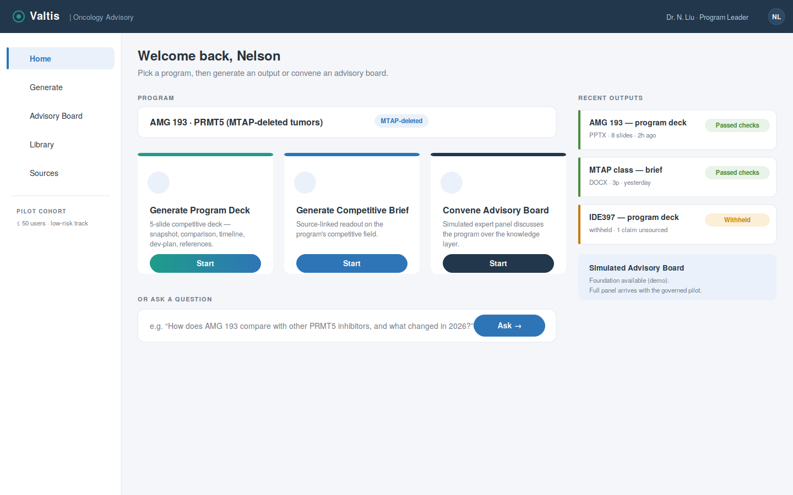
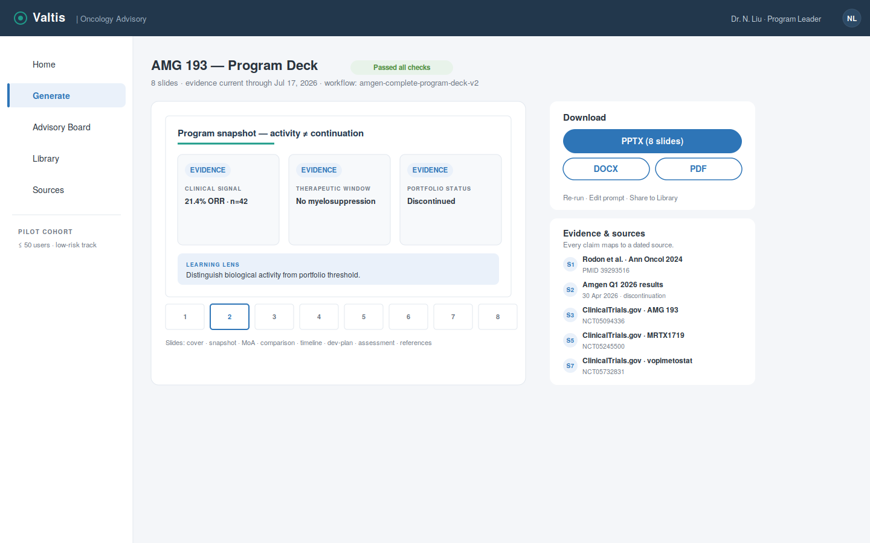
The Frontdoor & Grounded Output Generation
Phase 1 delivers the service surface and the generators behind it. The example output is an AMG-193-style program deck — every claim source-linked. Some UX proposals
Frontdoor — select a program, then Generate Deck / Brief or Convene Advisory Board.
Result — preview, one-click PPTX/DOCX/PDF export, and the evidence trail for every claim.
Fail-closed by design: the deck is composed to a fixed slide contract (snapshot · comparison · timeline · development plan · assessment · references) and released only if every material claim carries a dated source. Otherwise it is withheld with the specific gap shown.
SHI | Confidential & Proprietary Information

Slide 5
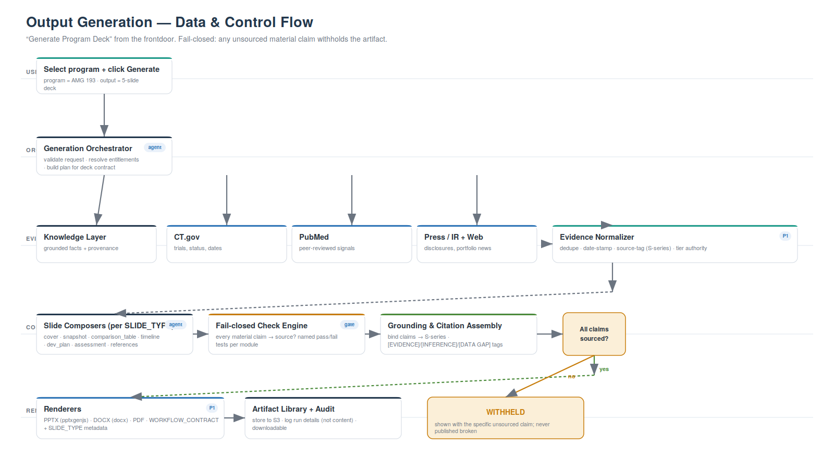
Output Generation — How a Deck Is Built
From a single click to a governed artifact: retrieve grounded + real-time evidence, compose to contract, check fail-closed, render and deliver.
SHI | Confidential & Proprietary Information

Slide 6
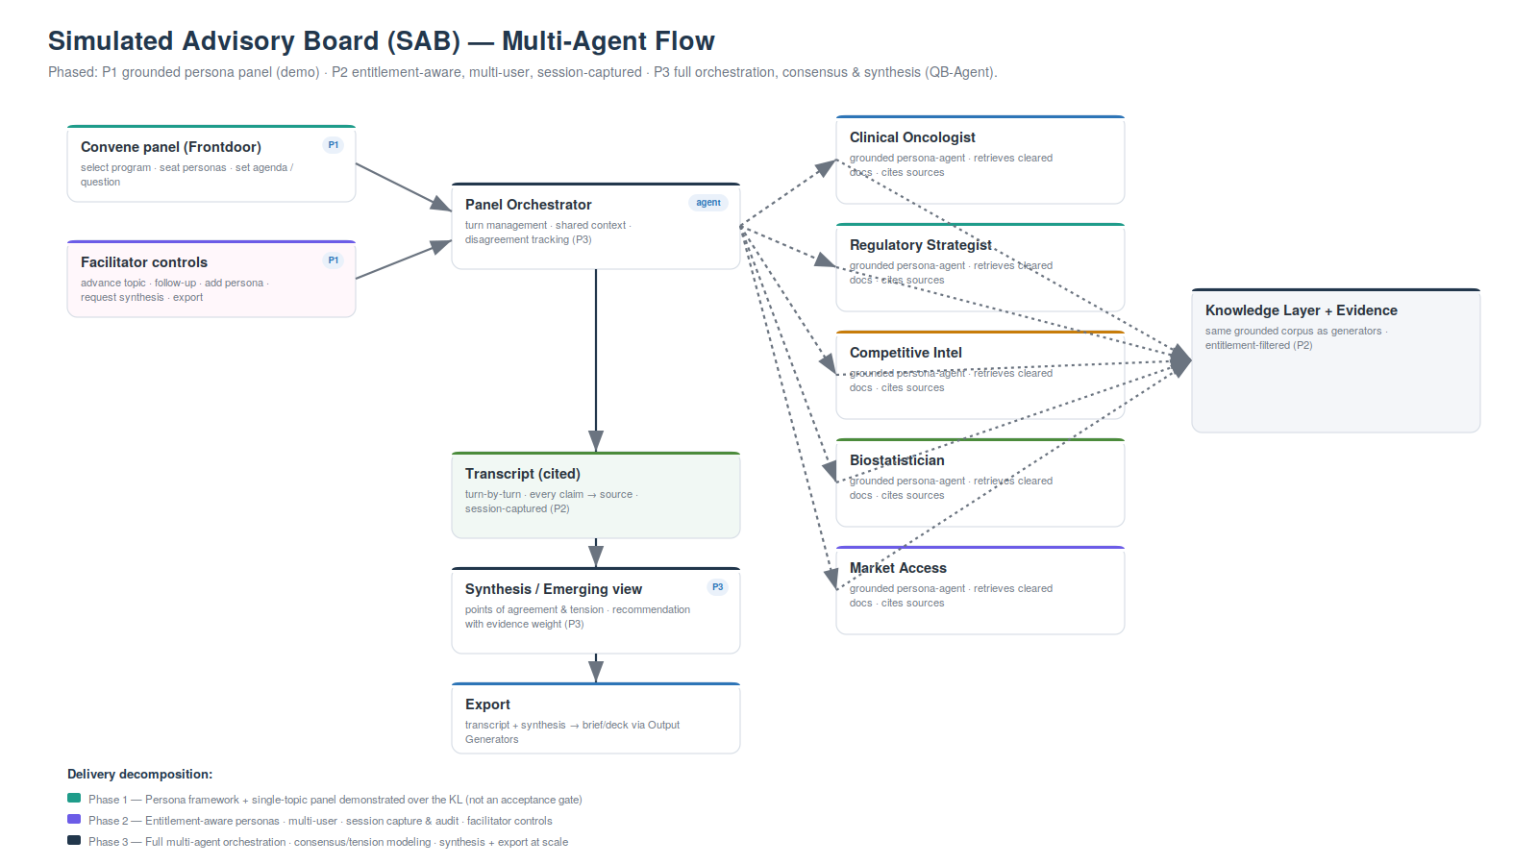
Simulated Advisory Board — Componentized Across Phases
A panel of grounded expert personas discusses a program over the same knowledge layer. Delivered in stages; the Phase-1 foundation is a demonstration, not an acceptance gate.
Phase 1 — Foundation
Persona framework + single-topic panel demonstrated over the knowledge layer, grounded and cited. Seeds the experience; shaped in AZ-facilitated sessions.
Phase 2 — Governed
Entitlement-aware personas, multi-user access, session capture & audit, facilitator controls — usable by the pilot cohort.
Phase 3 — Advanced
Full multi-agent orchestration (QB-Agent): consensus/tension modeling, synthesized recommendation with evidence weight, export to deck/brief.
SHI | Confidential & Proprietary Information

Slide 7
Three-Phase Delivery Plan
Staged and fixed-scope. Phase 1 is defined; Phases 2–3 are indicative, scoped at each gate.
* Phases 2–3 shown indicative; detailed scope & fixed fee confirmed at each gate following successful prior-phase delivery.
PHASE 1 · 12 WEEKS
PHASE 2 · ~10 WEEKS
PHASE 3 · ~8 WEEKS
Secure Surface & Generation
Governance & Multi-User
Product Maturity & Scale
Discovery, security scans, gap & readiness spec
Containerize; AWS landing zone (MASS); IaC, CI/CD, monitoring
SSO/SAML AuthN, persona RBAC (AuthZ), sessions
Frontdoor UX + report-generator buttons + waiting/failure screens
Deck & brief generators (fail-closed) + PPTX/DOCX/PDF export
Real-time competitor evidence; SAB foundation (demo)
Source→user entitlement + classification-aware retrieval
Audit trail, sessions, token/cost governance
Query-side grounding, guardrails, eval harness
Governance UX + admin console
SharePoint connector (pulled forward) + BIKG
SAB governed & multi-user; pilot go-live ≤50 SMEs
Expanded output templates + advanced exporters
Semantic cache + 'top queries'
Feedback-driven analytics dashboards
Additional connectors; pluggable model gateway
SAB advanced — multi-agent synthesis (QB-Agent)
Scale-out toward 500+ concurrent users
12 wks · $343k
~10 wks · indicative
~8 wks · indicative
Gates: G1 — secure Valtis live on AWS with SSO + working deck/brief generation (end Phase 1) · G2 — governed pilot live to ≤50 SMEs (Phase 2) · G3 — extensible platform, scale to 500+ (Phase 3).
SHI | Confidential & Proprietary Information

Slide 8
Resourcing & Roles — Phase 1
A lean, senior squad over 12 weeks; front-end and output-generation weighted for the frontdoor & generators.
Role | Location | Allocation | Weeks | Key responsibilities (scope ref)
Project Manager | Offshore | Part-time | W1–12 | Delivery oversight, governance reviews, RAID & handover (F18)
Solution Architect / Tech Lead | Onshore | Part-time | W1–12 | Target architecture, generator & SAB design, AZ/SHI liaison (F02)
AI / MLOps Engineer | Onshore | Full-time | W1–12 | Assessment, RAG/grounding, report generator, artifact exports, orchestration (F01,F13–F16)
Cloud Integration Engineer | Onshore | Full-time | W1–12 | SSO/SAML, RBAC, sessions, service integration (F07–F09)
DevOps Engineer | Offshore | Part-time | W1–12 | Containerize, MASS landing zone, IaC/CI-CD, CloudWatch (F03–F06)
Front-End Developer (React) | Offshore | Full-time | W3–12 | Frontdoor UX — buttons, waiting/failure, library (F10–F12)
UX Designer | Offshore | Part-time | W1–12 | Frontdoor journey, deck and report generation & citation flows (F10–F12)
Data Scientist | Offshore | Full-time | W1–12 | Evidence tiering, fail-closed checks, eval design (F16,F13)
Security Engineer | Offshore | Full-time | W7–12 | SAST/DAST, SSO/AuthZ hardening support (F01,F07,F08)
QA Engineer | Offshore | Part-time | W3–12 | Test across deploy, AuthN/AuthZ, generators, UX (F03–F17)
Peak concurrency ~6 FTE · blended on/offshore mix; delivery accelerated by internal engineering automation (see internal plan). Fixed fee covers services only.
SHI | Confidential & Proprietary Information

Slide 9
Appendix — Phase 1 Scope Register
Structured for direct conversion into the SOW's In-Scope / Out-of-Scope tables.
In scope — Phase 1
Out of scope for Phase 1 (Phase 2 / 3 / separate)
F01 Current-state assessment — code/arch review, SAST/SCA/secrets/container/DAST
F02 Gap analysis + production-readiness spec + target architecture
F03 Containerization of Valtis (engine + advisory app + generators)
F04 AWS landing zone via MASS — ECR, Fargate, Secrets Mgr, S3, RLS Postgres
F05 Terraform IaC + CI/CD pipeline
F06 CloudWatch monitoring, logging & alerting
F07 SSO/SAML authentication (AuthN) with AZ IdP
F08 Authorization (AuthZ) — persona RBAC + baseline user management
F09 Session handling for authenticated multi-user access
F10 Frontdoor UX — sign-on, program select, generate buttons, downloads
F11 Honest waiting & failure screens; citations & feedback controls
F12 Artifact library (list, download, re-run)
F13 Output generators — 5-slide program deck + competitive brief to fixed contract
F14 Fail-closed check engine — named pass/fail tests; withhold on unsourced claim
F15 Exporters — PPTX / DOCX / PDF with workflow-contract metadata
F16 Real-time evidence service — CT.gov, PubMed, press/IR, web (dated, source-linked)
F17 SAB foundation — grounded persona panel demonstrated over the KL (demo)
F18 Runbook, admin/user guides, architecture document, handover
O01 Source→user entitlement propagation & classification-aware retrieval — Phase 2
O02 Conversation audit trail & advanced session/memory governance — Phase 2
O03 Token/cost tracking & model-gateway cost governance — Phase 2
O04 Guardrails & eval/red-team harness (beyond fail-closed checks) — Phase 2
O05 Governance-aware admin console & usage dashboards — Phase 2
O06 SharePoint & BIKG connectors — Phase 2 (pulled forward from P3)
O07 SAB governed & multi-user (entitlement, session capture, facilitation) — Phase 2
O08 CISO full hardening & pen-test remediation — Phase 2 (baseline scans in P1)
O09 Expanded output templates & advanced exporters — Phase 3
O10 Semantic cache, analytics, pluggable gateway — Phase 3
O11 SAB advanced — multi-agent synthesis & consensus (QB-Agent) — Phase 3
O12 Source-data licensing clearance (congress transcripts) — AZ-led, separate
O13 Ongoing maintenance, support & SLA after handover — separate SOW
SHI | Confidential & Proprietary Information

Slide 10
Appendix — Key Assumptions
Grouped to map onto the SOW. Any invalidated assumption is raised immediately and handled via change request.
Infrastructure
Data, Model & Content
AWS landing zone via MASS — ECR, Fargate, Secrets Mgr, S3, networking, egress
Migrated Postgres knowledge layer available as the single write target (RLS)
Non-GxP; no PHI / patient-level data; public + licensed sources only
Single AWS region for Phase 1
Valtis code + ~400-test suite provided at kickoff; generators/prompts provided
Approved LLM via AZ AI-Gateway + token budget by week 2
Prompts, rubrics & fail-closed gates stay under AZ change authority
Frozen pilot corpus confirmed at Gate 1; congress licensing cleared by AZ
Access, Security & Sources
Organizational & Commercial
Scoped, NDA-covered access by kickoff (gates the 12-week clock)
SSO/SAML IdP endpoints by week 3
External-source egress (CT.gov/PubMed/press/web) allow-listed; rate limits acceptable
Baseline scans + SSO in P1; full CISO hardening & pen-test in P2
MSA/confidentiality via SHI procurement (Kieran, UK) before start
One committed output confirmed; pre-agreed fallback (brief) fixed at Gate 1
AZ sponsor + SMEs in weekly review; feedback within 48h of demos
Fixed scope, gated; changes via change request. Price = services only
SHI | Confidential & Proprietary Information

Slide 11
Appendix — Dependencies & Customer Responsibilities
Owners and dates confirmed at SOW review; DEP1–DEP3 gate the start of the Phase 1 clock.
ID | Dependency | Owner | Required by | Impact if delayed
DEP1 | Scoped, NDA-covered access to AZ's AWS landing zone (via MASS) | AZ IT / MASS | Kickoff | Blocks all deployment
DEP2 | Migrated Postgres knowledge layer + frozen pilot corpus | AZ Data | Week 2 / Gate 1 | Blocks generation
DEP3 | MSA / confidentiality executed via SHI procurement | SHI (Kieran) + AZ | SOW review | Blocks start
DEP4 | SSO/SAML IdP endpoints & configuration | AZ IdP team | Week 3 | Blocks AuthN / AuthZ
DEP5 | Approved LLM via AZ AI-Gateway + token budget | AZ AI Platform | Week 2 | Blocks generation
DEP6 | External-source egress allow-listing (CT.gov/PubMed/press/web) | AZ Security / Cloud | Week 4 | Blocks real-time evidence
DEP7 | Prompts, rubrics & fail-closed gates (content authority) | AZ (Nelson) | Ongoing | Blocks output quality sign-off
DEP8 | AZ sponsor & SME availability; feedback within 48h of demos | AZ (Ross/Nelson) | Weekly | Risks schedule slip
SHI | Confidential & Proprietary Information

